Slide 1


Slide 2
Table Of Contents
01
02
Our team
The idea
03
04
Step at work
Technologies

Slide 3
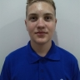
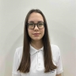
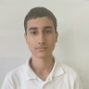
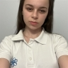
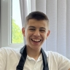
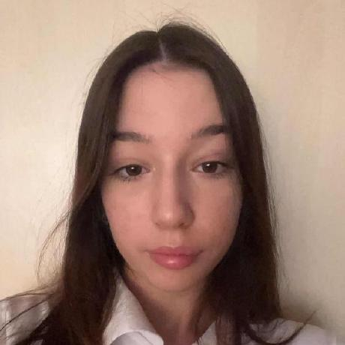
Our team
Aleksandar
Sivkov
10B
Ani
Vezirova
9G
Valentin
Lazarov
10G
Dariq
Kartalova
9G
Stanimir
Popov
10B
Kalina
Atanasova
9V

Slide 4
The idea:

Slide 5
Step at work
1
2
Team
Idea
3
4
Realization
Technologies

Slide 6







Technologies

Slide 7
Thanks!

